Slide 1
aspergillosis
Dr. Bincy Joseph
Assistant professor
PGIVER, Jaipur

Slide 2
Aspergillus fumigatus
Aspergillus flavus
Aspergillus niger
Aspergillus terreus
Aspergillus nidulans
It is a primary disease of respiratory system
Haematogenous dissemination to other organs occur, occasionally eye skin and meninges involved
Occur more frequently in avian sp.
In equine important cause of abortion
In ovine pulmonary disease
In bovine pneumonia, abortion and mastitis

Slide 3
In dog nasal aspergillosis
In cat intestinal and pulmonary aspergillosis
In avian occur in two form acute form seen in young birds with high mortality and morbidity
Aspergillosis in young birds leads to brooder pneumoniae ( Aspergillus fumigatus)
The important species responsoble for tissue invasion in animals is: Aspergillus fumigatus
Aspergillus flavus produce aflatoxin

Slide 4
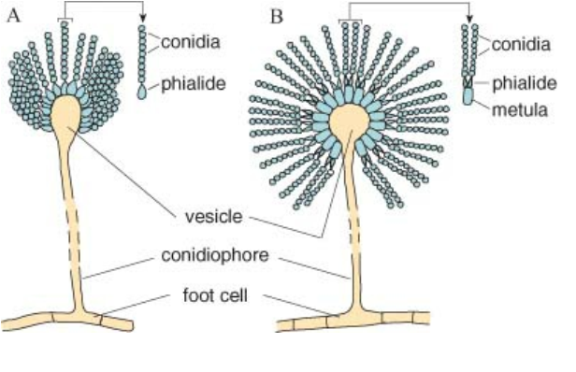
The phialides of A. fumigatus (A) are borne directly on the vesicle
(uniseriate) whereas those of A. niger (B) are borne on metulae (biseriate)

Slide 5
Symptoms of aspergillosis in birds
In young birds important symptoms are anorexia, convulsions, gasping and death.
This fungus can occasionally invade brain and CNS involvement cause paralysis, unilateral occular infection can also occur
Birds fail to grow and keep affected eyes closed and later develop cheesy exudate in conjuctival sac.
In adult birds mortality less than 5% and symptoms are anorexia, coughing, gasping and rapid loss of body weight.
Death by asphyxia due to blockage of trachea by exudate

Slide 6
Clinical signs in animals
Clinical signs in domestic and pet animals often resemble pneumoniae
Symptoms are increased temperature, mucopurulent nasal discharge and conjuctivitis.
Bovine mycotic abortion due to aspergillosis at 3-8 months of pregnancy
In 60% of cases ROP (retension of placenta) intercotyloedonary area thickened and leathery and the cotyledons are necrotic
Guttural pouch mycoses in horses

Slide 7
Gross lesions in birds
Greenish yellow caseous exudate in lung and air sac
Air sac are thickened, besides raised nodules are seen in air sac and lungs
Raised nodules are yellowish and yellowish white with necrotic centre
Such nodules are known as button ulcer

Slide 8
diagnosis
Certain specific condition such as guttural pouch mycoses may suggest involvement of aspergillus sp.
For confirmation, tissue invasion by fungi may be demonstrated and spergillus species may be isolated
Tissue sections are stained by periodic acid schiff method
Small scrapings of tissues from air passage are examine in 10% KOH. This will demonstrate septate hyphae, conidiophore, vesicle, sterigmata and conidiospore

Slide 9
Isolation of fungus on SDA/ blood agar without cycloheximide because the organism are sensitive to heat.
Identification by colony appearance and microscopic morphology
Serological test as agar gel immunodiffusion, ELISA and counter immunoelectrophoresis
PCR to demonstrate the organism in clinical specimens

Slide 10
Treatment
Nystatin, Amphotericin B and Ketoconazole

Slide 11
Candida albicans
Candida albicans is the species most often
implicated in animal disease.
It grows aerobically at 37°C on a wide range of media including Sabouraud dextrose agar
Colonies are composed of budding oval cells
In animal tissues, C. albicans may exhibit polymorphism in the form of pseudohyphae or hyphae
On certain media, (Corn meal agar) it characteristically produces thick-walled resting cells known as chlamydospores (chlamydoconidia).

Slide 12
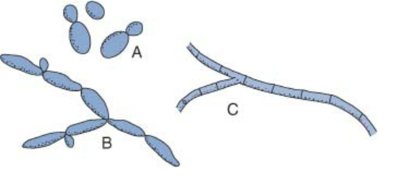
Three forms of the polymorphic yeast Candida albicans:
budding yeast cell (A); pseudohypha (B); true septate hypha (C).

Slide 13
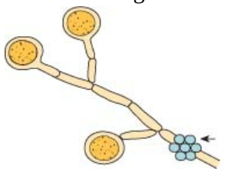
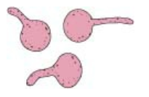
Thick-walled resting cells of Candida albicans, called chlamydospores (chlamydoconidia). These resting cells are formed from pseudohyphae when submerged colonies grow in cornmeal agar. The smaller cells are blastoconidia
Germ tubes form within 2 hours when cells of Candida albicans are incubated in serum at
37°C.

Slide 14
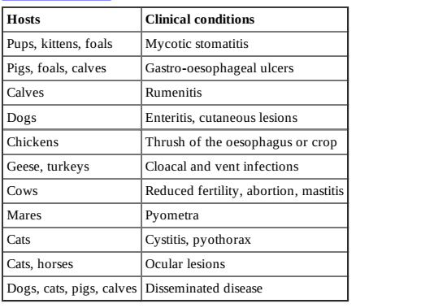
Clinical conditions

Slide 15
diagnosis
Suitable specimens for culture and istopathology include biopsy or post-mortem tissue samples
and milk samples.
Tissue sections, stained by PAS or methenamine silver methods, may reveal budding yeast cells
or hyphae.
Culture is carried out aerobically at 37°C for 2 to 5 days on Sabouraud dextrose agar, with or
without cycloheximide.
Identification criteria for isolates:
– Characteristic colonies yielding budding yeast cells.
– Growth on media containing cycloheximide (specific for C. albicans).
– Colonial appearance on CHROMagar Candida.
– Biochemical profile.
– Chlamydospore and germ tube production (specific for C. albicans).
Molecular techniques have been used for the identification of Candida species in clinicaleterinary samples

Slide 16
mycotoxins
Mycotoxins, secondary metabolites of certain fungal species, are produced when toxigenic strains of these organisms grow under defined conditions on crops, pasture or stored feed
The acute or chronic intoxication following ingestion of contaminated plant material is termed mycotoxicosis
Many of these fungi belong to the genera
Penicillium, Aspergillus, Fusarium and Claviceps

Slide 17
Mycotoxins, a diverse group of heat-stable, low molecular weight compounds, are non-antigenic
Ingestion of contaminated plant material or contaminated crops may induce a characteristic disease process
Susceptibility can vary with species, age and sex
The effects of mycotoxins include immunosuppression, teratogenesis or carcinogenesis
Diseases caused by mycotoxins (mycotoxicoses) are non-contagious, tend to be sporadic, seasonal and
associated with certain batches of feed
Diagnosis is based on clinical presentation and on demonstration of significant levels of a specific mycotoxin in feed or in animal tissues

Slide 18
Characteristics of mycotoxin
Low molecular weight, heat-stable substances
Unlike many bacterial toxins, non-antigenic; exposure does not induce a protective immune response
Many are active at low dietary levels
Specific target organs or tissues affected
Toxic effects include immunosuppression, mutagenesis, teratogenesis and carcinogenesis
Accumulation in tissues of food-producing animals or excretion in milk may result in human exposure

Slide 19
Epidemiological clinical features of mycotoxicoses
Outbreaks usually seasonal and sporadic
No evidence of lateral spread to in-contact animals
Certain types of pasture or stored feed may be involved
Clinical presentation is usually ill-defined
Increased susceptibility to infectious disease may be evident
Severity of clinical signs is influenced by the amount of mycotoxin ingested; recovery is related to duration of
exposure
Occurrence of vaccination failure may be increased
Antimicrobial medication is ineffective
Confirmation requires demonstration of significant levels of mycotoxin in feed or in tissues from affected animals

Slide 20
aflatoxicosis
Fungi associated with the production of aflatoxins, the mycotoxins which cause aflatoxicosis, include Aspergillus flavus, A. parasiticus and A. nominus
difuranocoumarins
Although four prominent aflatoxins, namely B1, B2, G1 and G2,
Aflatoxin B1, which is the mycotoxin most often
encountered in disease outbreaks
The liver is the principal organ affected by aflatoxins, resulting in hepatocellular necrosis and impaired liver function.
In cattle, aflatoxin B1, which escapes rumen degradation, is converted into a hydroxylated form called aflatoxin
M1, which is excreted in milk
The toxic effects include reduced protein synthesis, carcinogenesis,
teratogenesis and aplasia of the thymic cortex leading to depressed cell-mediated immunity

Slide 21
Clinical findings
Ducklings, turkey poults, calves,
pigs and dogs are sensitive to toxic effects, whereas sheep and adult cattle are more resistant.
Aflatoxicosis is uncommon in horses and goats
Acute aflatoxicosis has been recorded in birds
and cattle.
Ataxia, opisthotonos and sudden death are features of the acute disease in ducklings.
Hepatopathy is a common finding and, in birds more than 3 weeks old, subcutaneous haemorrhages
may be evident.
Haemorrhagic diathesis, probably related to hepatopathy, is a characteristic of acute
toxicity in chickens and turkeys.

Slide 22
Acute aflatoxicosis in cattle may rapidly result in death
In affected calves, blindness, circling, tenesmus, diarrhoea and convulsions have been recorded.
Low levels of aflatoxins fed to young pigs depressed their cell-mediated and humoral immune responses and increased their
susceptibility to infectious agents.
Clinical signs of aflatoxicosis in dogs include depression, anorexia, vomiting, diarrhoea, jaundice and epistaxis.

Slide 23
Diagnosis
Except in outbreaks of acute disease, clinical signs are vague.
Aflatoxin may be demonstrated in tissues
obtained at post-mortem.
Procedures for aflatoxin detection in feed and tissues include:
– Immunoaffinity columns which are sometimes used for sample purification to improve
sensitivity.
– Thin-layer chromatography. Chromatograms are examined under UV light for the four main
toxins on the basis of position and fluorescence. The fluorescence of aflatoxins B1 and B2 is blue
and with G1 and G2 it is green.
– High-performance liquid chromatography.
– Ultra-performance liquid chromatography combined with mass spectrometry.
– Immunoassay techniques such as ELISA and radioimmunoassay procedures.
– Biological assays such as bile duct proliferation in ducklings, chick embryo bioassays, brine
shrimp larvae tests and trout embryo bioassays.

Slide 24
Prevention and control
The growth of fungal contaminants on stored feed should be limited by appropriate measures following harvesting and during storage.
Batches of food for human and animal consumption may be monitored for aflatoxin contamination.
Treatment with ammonia gas at high temperature and pressure has been used to detoxify contaminated batches of feed.
Aflatoxins B1 and G1 are rapidly degraded by 2% ozone but aflatoxins B2 and G2 are more resistant and require treatment with 20% ozone for rapid degradation.
Addition of hydrated sodium calcium aluminosilicate to feed is reported to reduce aflatoxin toxicity
Glucomannan-containing polymers extracted from yeast cell walls have a high adsorptive capacity for binding different mycotoxins including aflatoxin B1

